Slide 1

Computer and Internet Monitoring Software

Slide 2
Contents
What is Controlio?
Who Benefits from Controlio?
Which productivity challenges does controlio address?
How does it work?
Deployment Options
Main features
Contacts

Slide 3

What is Controlio?

Slide 4
Who benefits from Controlio?
Middle and Top Managers: View and manage how employees (in-office and remote) use their working hours
HR department: Redistribute workload between employees & detect who has a burnout risk.
IT specialists: Investigate insider threats, control internet & computer use, and detect unused licensed applications.
Employee: Self-monitor to achieve a sustainable level of productivity improvement.

Slide 5
Which productivity challenges does Controlio address?
Get answers to the following questions:
Are my employees (in-office & remote) productive?
Which websites do your employees devote most time to?
How many hours has an employee worked (Daily/Weekly/Monthly)?
Who of your employees spends most time using chats and playing games?
Are the employees using the computer or are they distracted by some other business?
At which hours/days is the employee active the most or the least?
Who comes late for work & who leaves early?

Slide 6
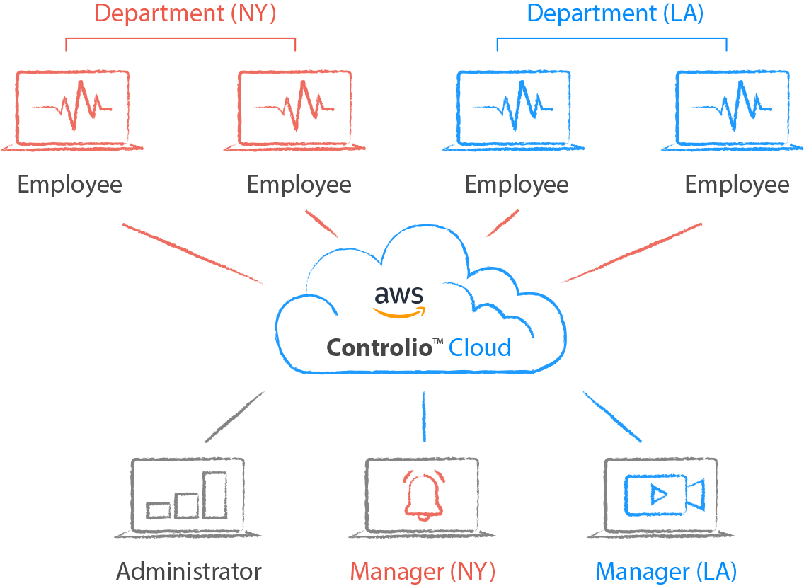

How does it work?
Notes:
Controlio’s client agent can be installed locally on an employee’s computer or remotely over LAN. Windows OS and macOS are supported. Once it’s installed, the client agent will upload data to the Controlio Cloud and it will be available for account admins and managers from the Web Console on Controlio.net.

Slide 7
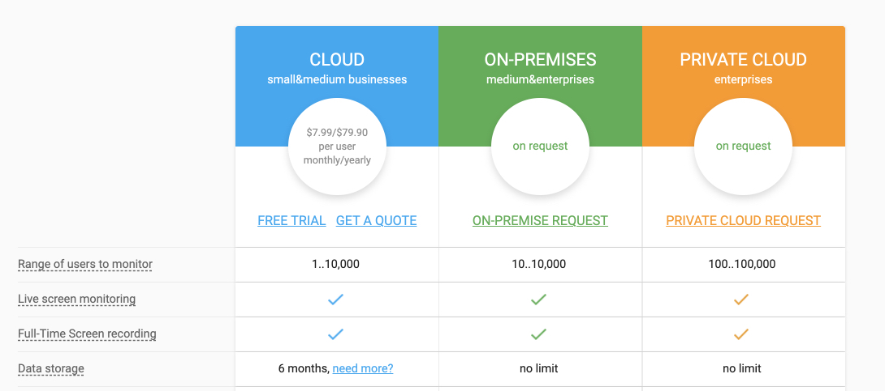
Deployment Options
Notes:
Cloud: Store data in a secure Amazon AWS Cloud environment managed by Controlio.
On premises: Deploy Controlio on a local server that will be managed by the Company.
Private Cloud: Deploy Controlio on a private AWS (or Linux/Docker compatible) Cloud Environment that will be managed by the Company.

Slide 8
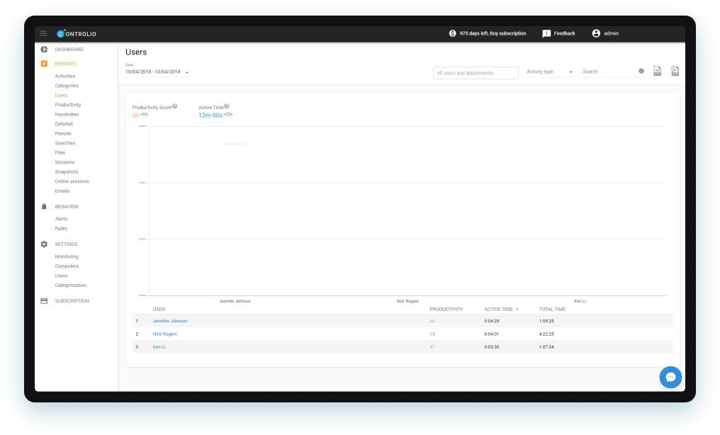
Productivity: Statistics
Automatic categorization of productive & distractive activities.
Productivity score calculation for users and departments.
Active (employee is using the computer) and Idle (away) time tracking.

Slide 9
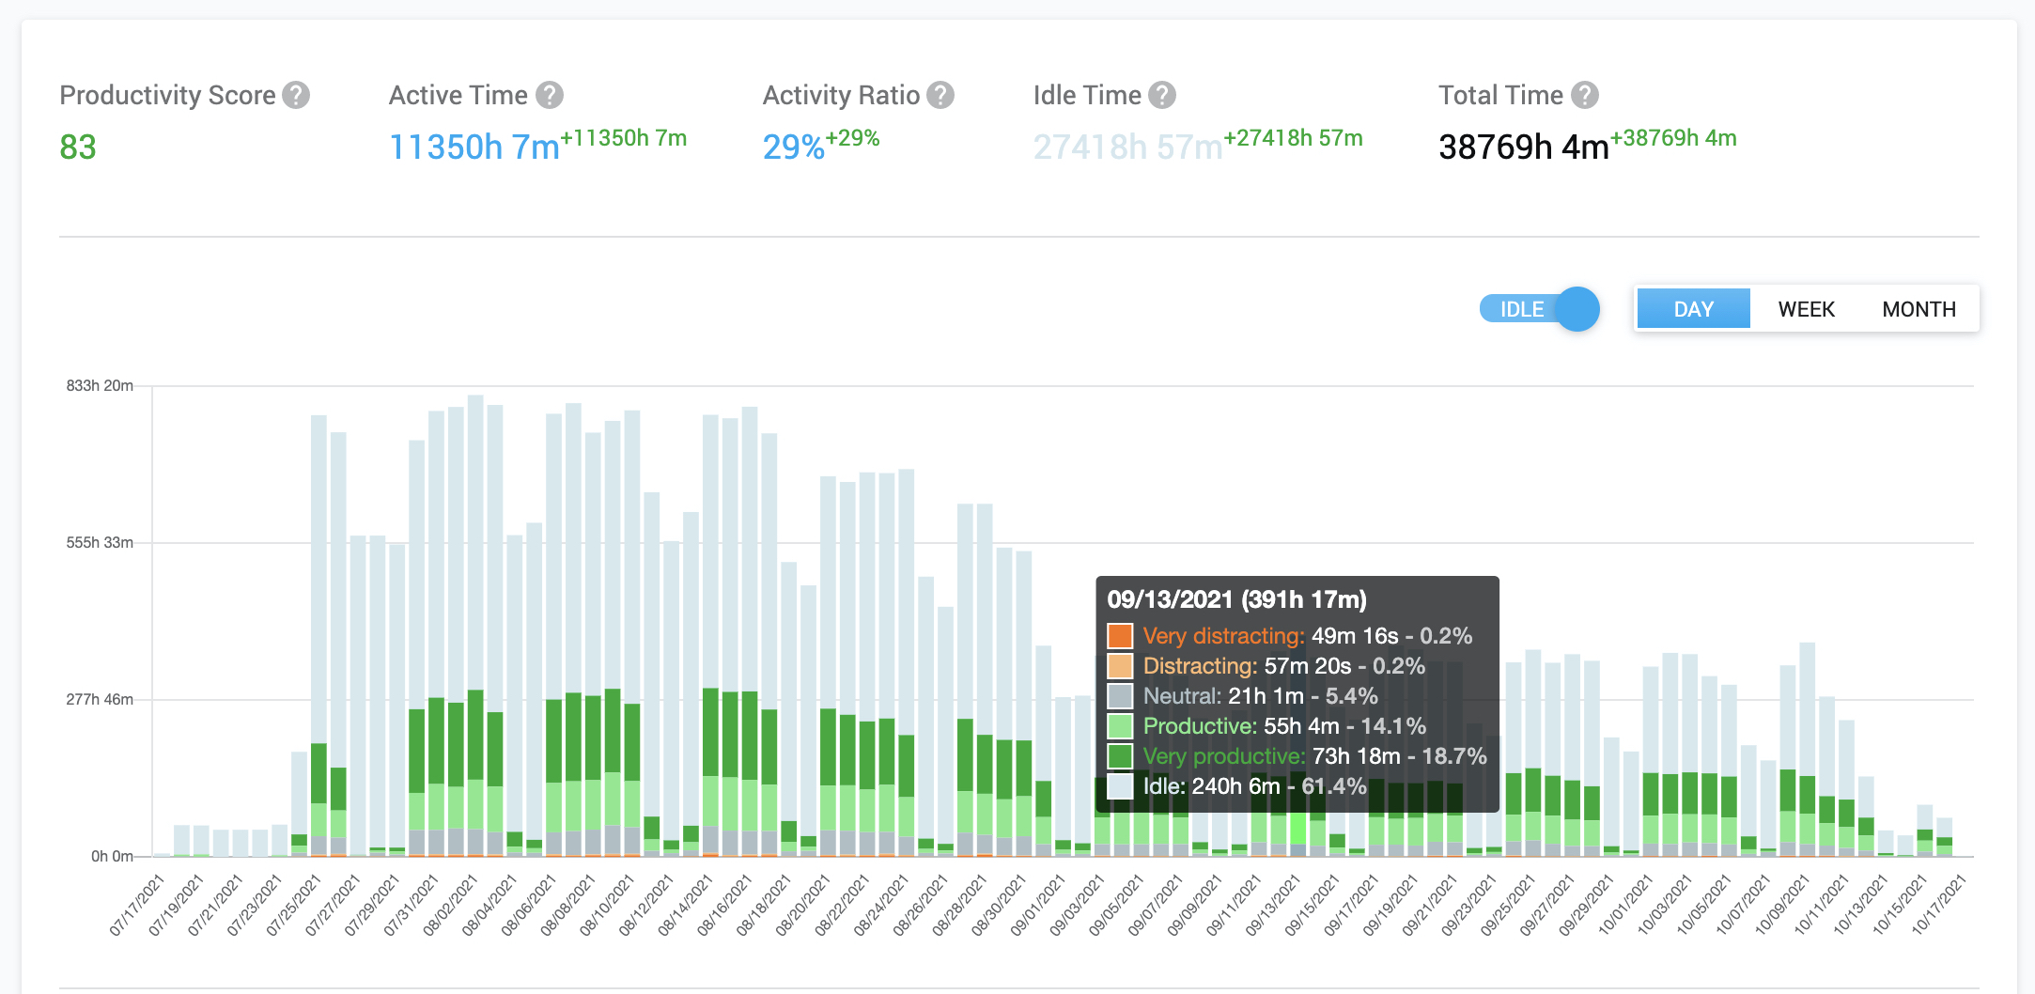
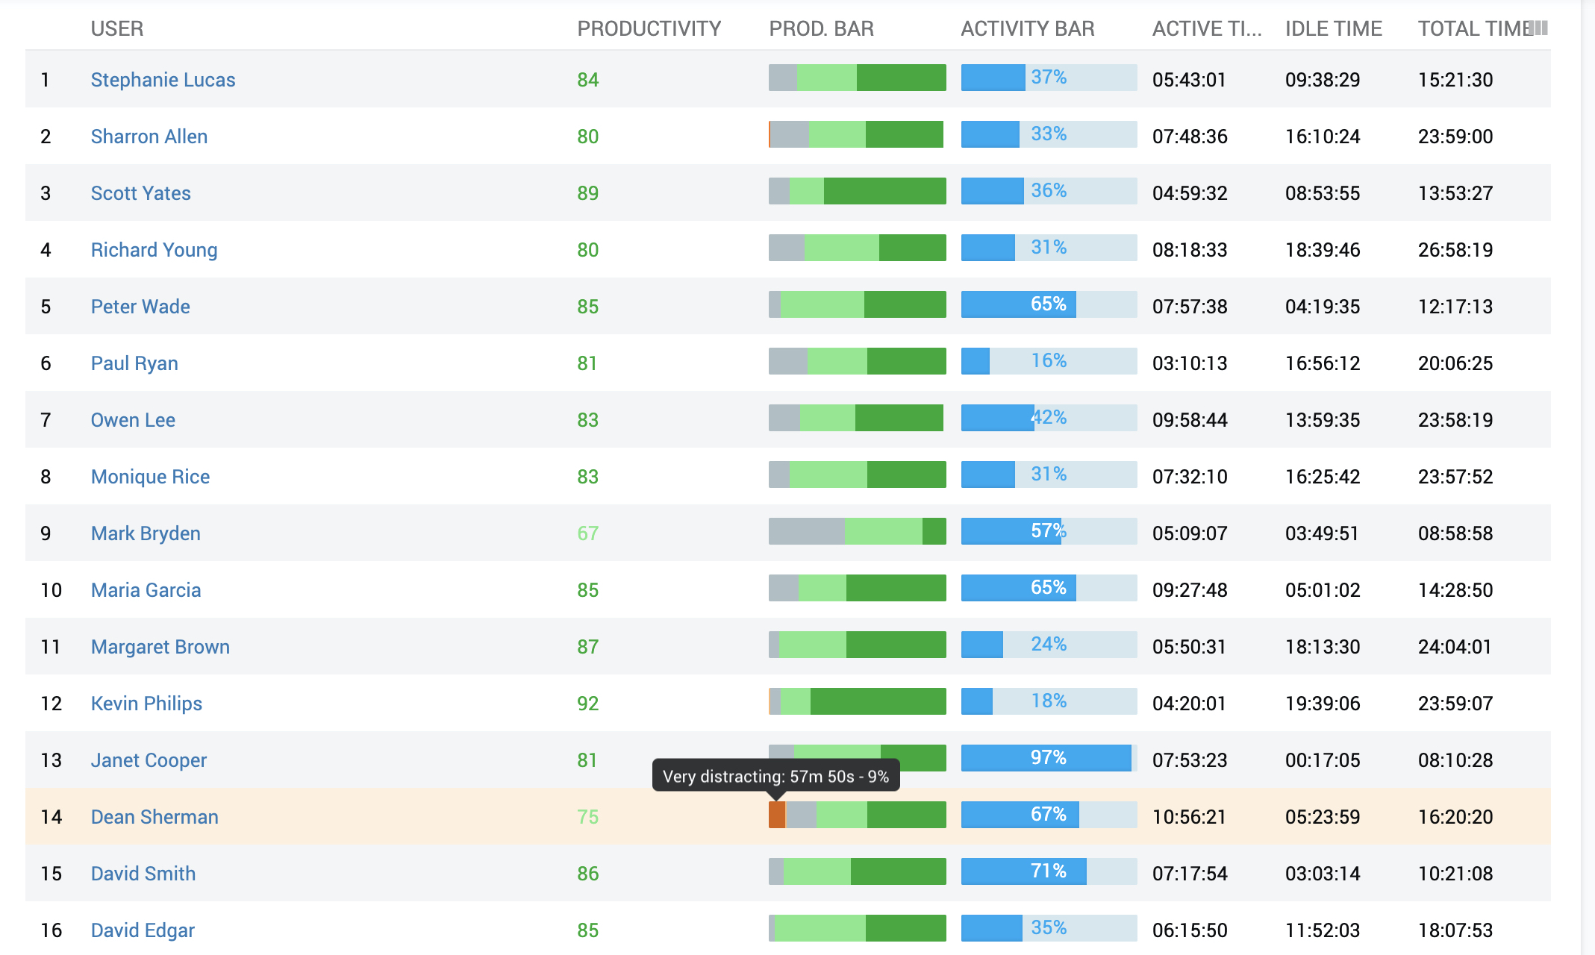
Productivity: Statistics
Automatic categorization of productive & distractive activities.
Productivity score calculation for users and departments.
Active (employee is using the computer) and Idle (away) time tracking.

Slide 10
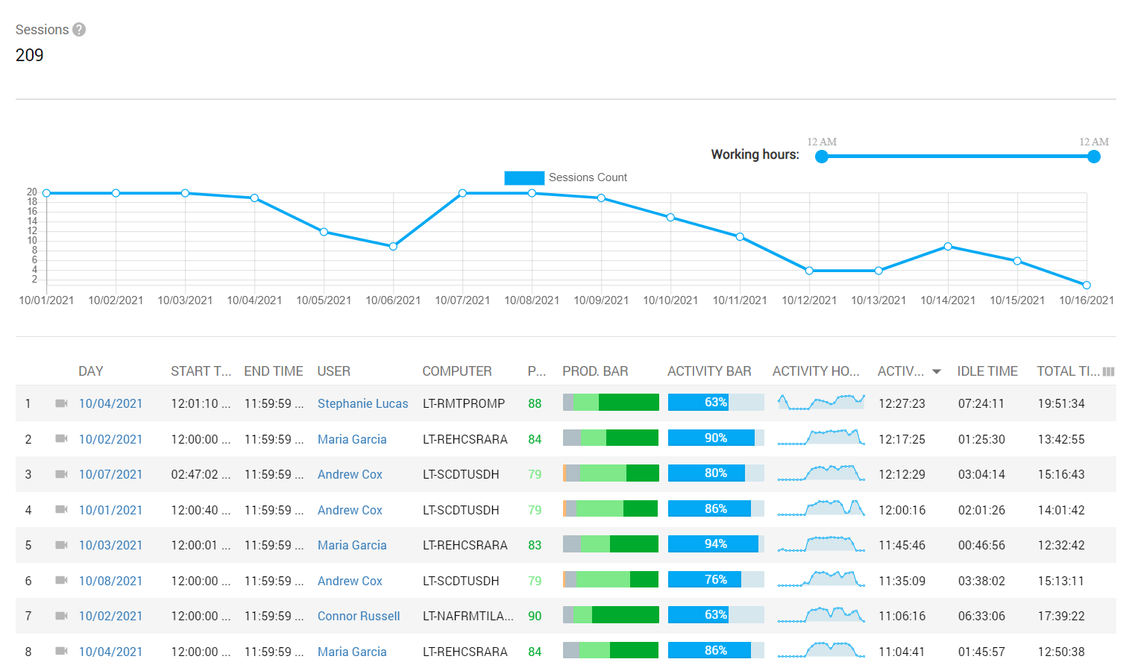
Productivity: Working Hours Tracking
Track working hours every day – by the very first and the very last user activity.
Working hours summary.
Detect productivity gaps and flops.

Slide 11
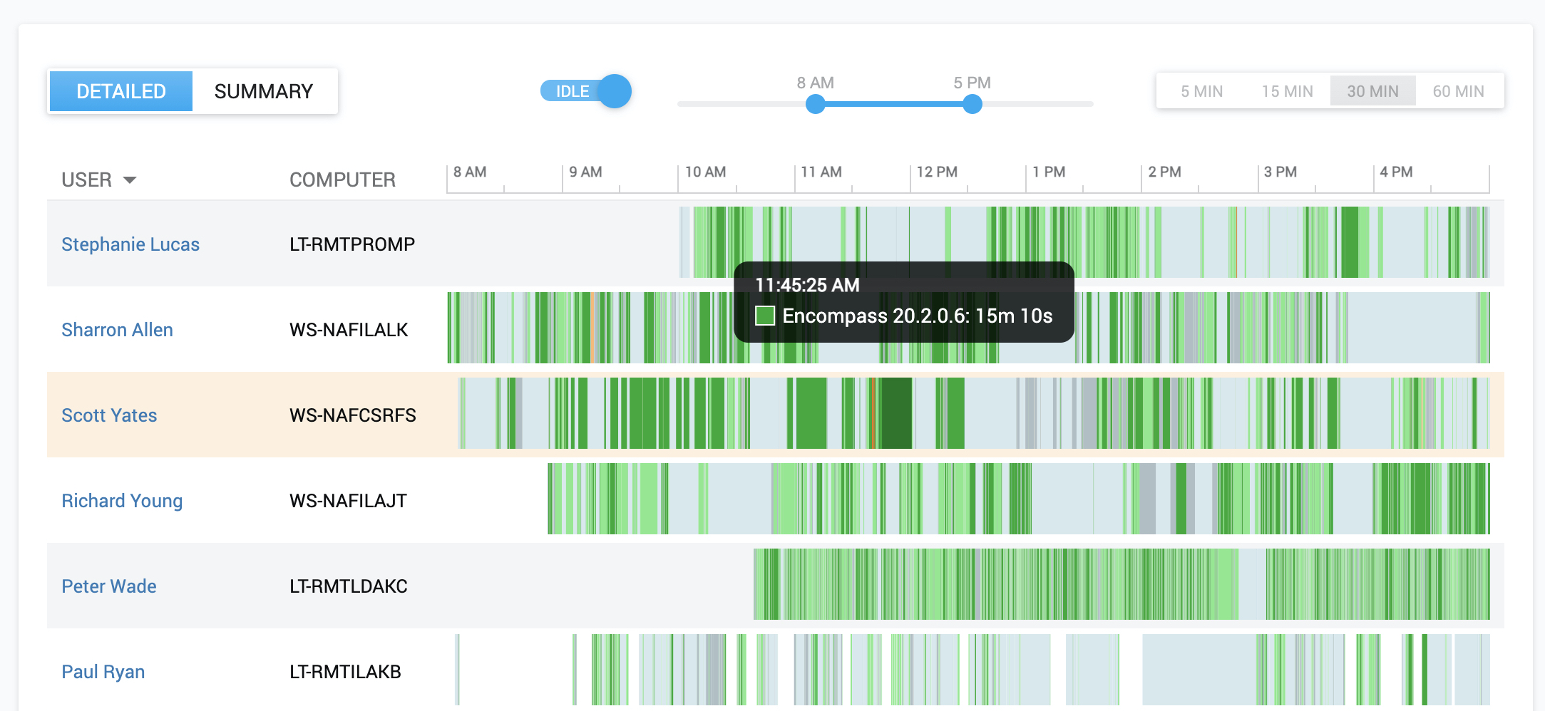
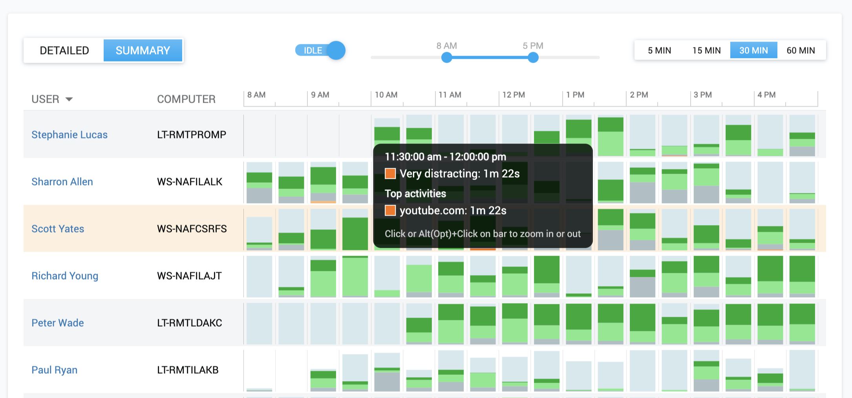
Productivity: Working Hours Tracking
Track working hours every day – by the very first and the very last user activity.
Working hours summary.
Detect productivity gaps and flops.

Slide 12
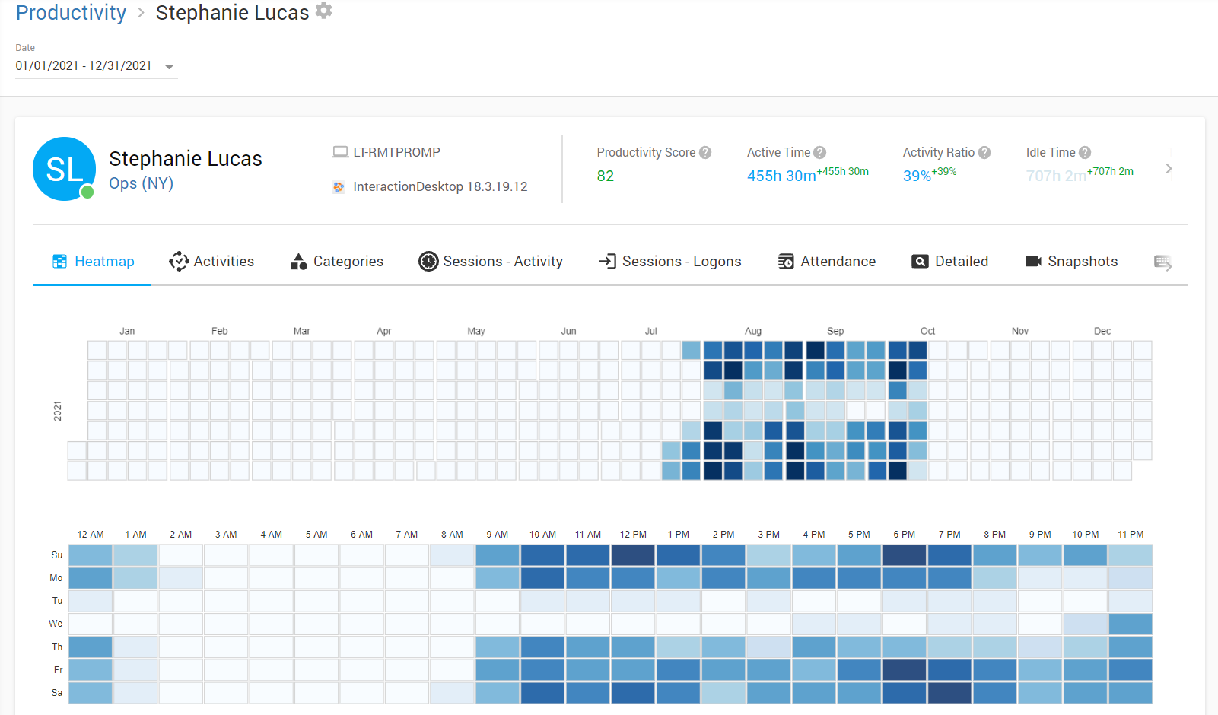
Productivity : User Digest
Utilize the heatmap to better tune up employees’ working schedules.
Various reports are gathered in one place to speed up investigation of individuals.

Slide 13

Track App & Web Activity
Calculates active time spent in certain programs and websites.
Flexible reporting features: various categories, filters, charts, and drill-downs.
Automatic categorization of Applications & Websites.

Slide 14
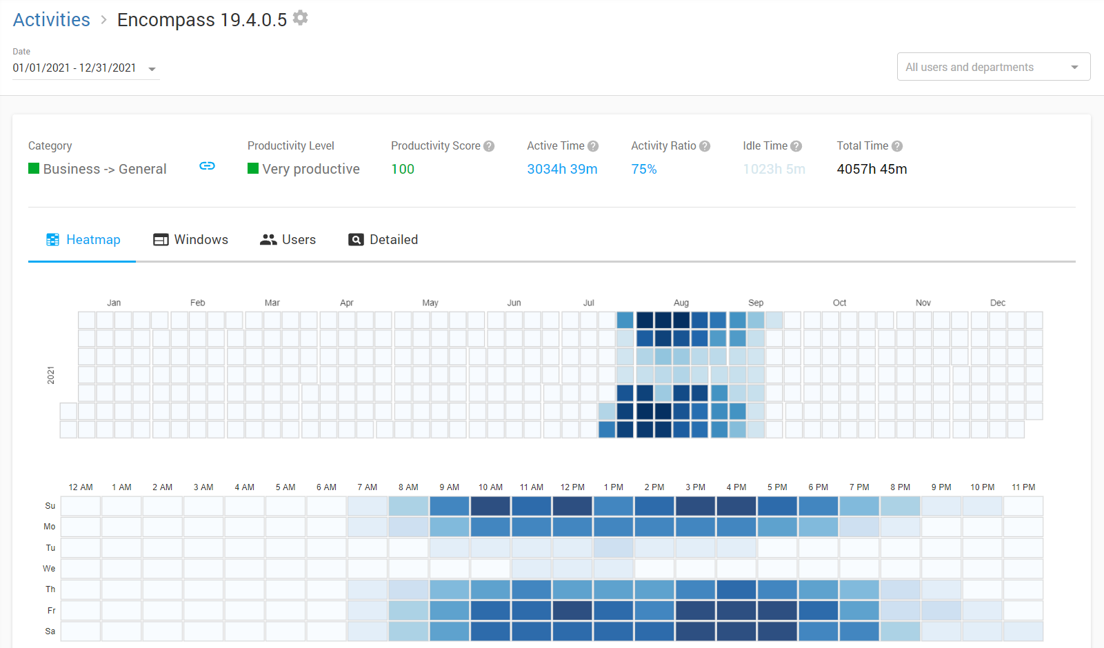
App & Web Utilization Report
Check at which days/hours is an activity being engaged the most or the least.
View for how long was each window instance of the activity being engaged.
Find out how much time each employee has spent engaging in this activity.

Slide 15

Real-time Surveillance
Watch the live stream of employees’ screens in real-time!
Check who is active or idle, and get the list of running apps and opened websites per user.

Slide 16
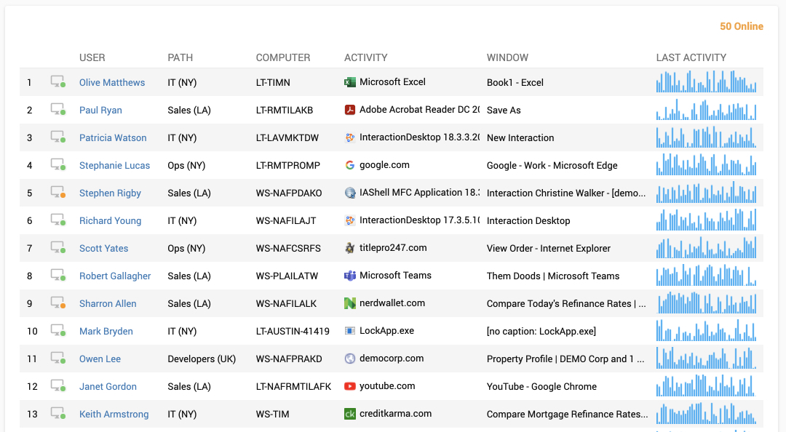
Real-time Surveillance
Watch the live stream of employees’ screens in real-time!
Check who is active or idle, and get the list of running apps and opened websites per user.

Slide 17

Behavior Rules & Alerts
Block Websites and Applications.
Receive e-mail notifications upon violations of behavior rules.
Get alerts on suspicious user activity linked with a screen video (case evidence).
Block USB flash drives.
Get a list of the top behavior rules violators.

Slide 18
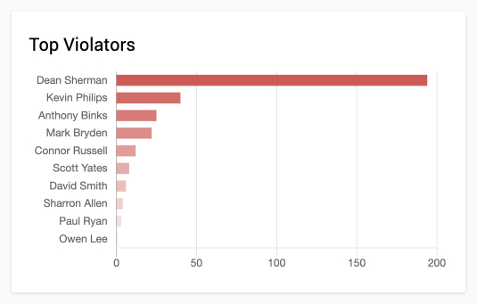
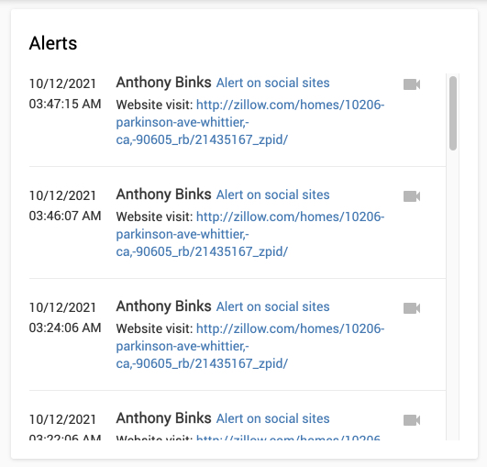
Behavior Rules & Alerts
Block Websites and Applications.
Receive e-mail notifications upon violations of behavior rules.
Get alerts on suspicious user activity linked with a screen video (case evidence).
Block USB flash drives.
Get a list of the top behavior rules violators.

Slide 19

Security Investigations: Continuous Screen Recording
Instead of taking screenshots, Controlio captures users’ screens with no gaps. You can watch the video later and run an activity report.

Slide 20
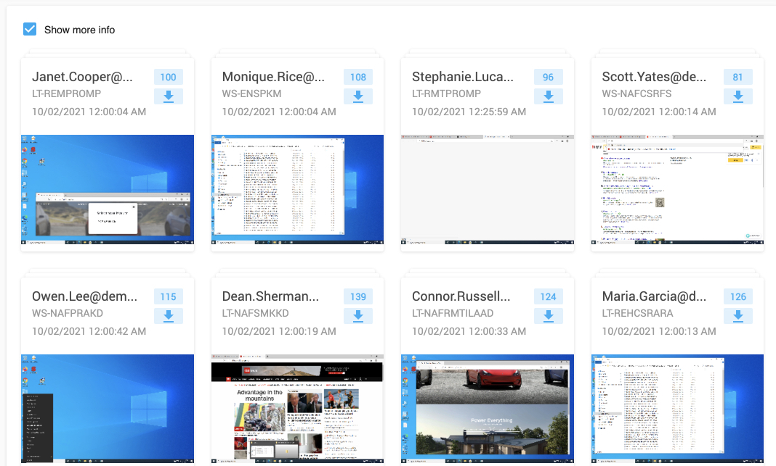
Security Investigations: Continuous Screen Recording
Screen recordings are linked with many reports (e.g. detailed App & Web usage, keystrokes, etc..).
Any user, department, application or website can be excluded from being recorded.

Slide 21
Security Investigations: Keylogging
Each keyboard stroke will be recorded, and functional keystrokes will be logged as well.
The report items will be linked with the screen recording of when the employee was typing these Keystrokes that may be used as forensic evidence!

Slide 22
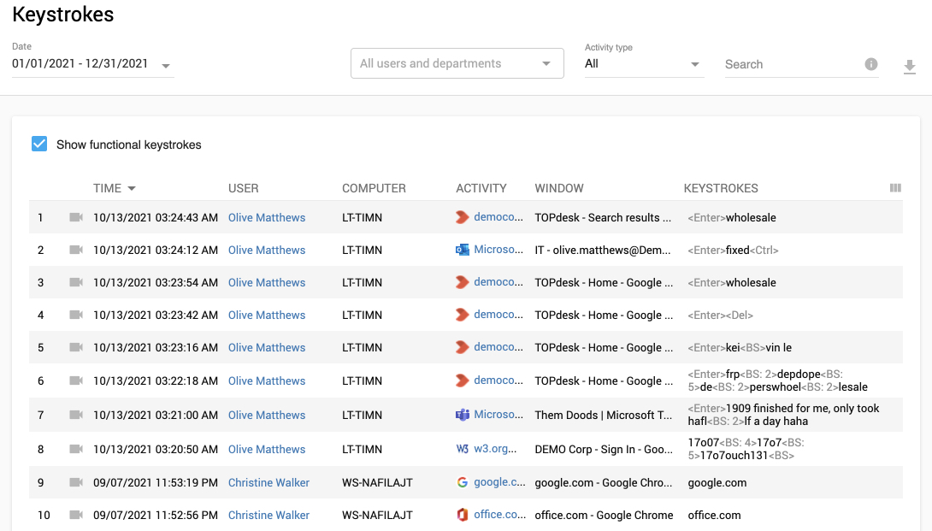
Security Investigations : Keylogging
Each keyboard stroke will be recorded, and functional keystrokes will be logged as well.
The report items will be linked with the screen recording of when the employee was typing these Keystrokes that may be used as forensic evidence!

Slide 23
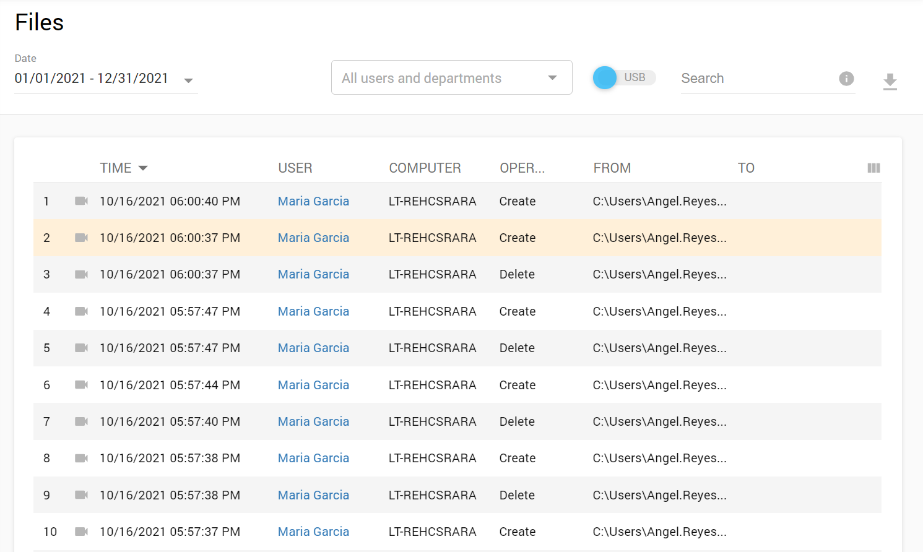
Security Investigations : File Operations
Detect file operations on the employee's PC or to/from USB removables. (e.g. Move, Delete, Rename, etc.).
The report items will be linked with the screen recording of the file operation that may be used as forensic evidence!

Slide 24
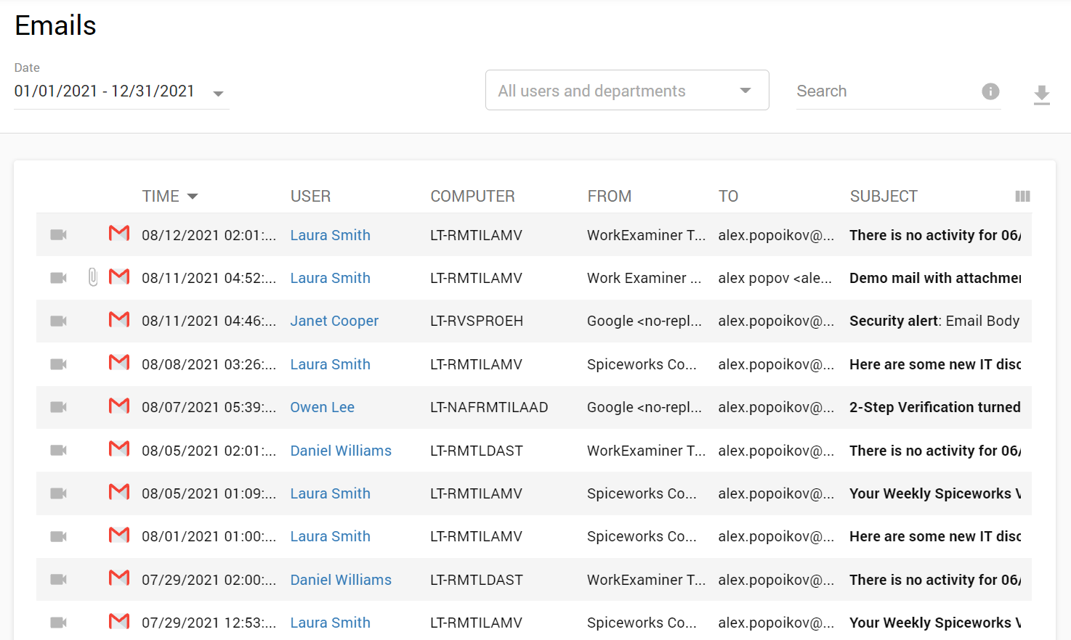
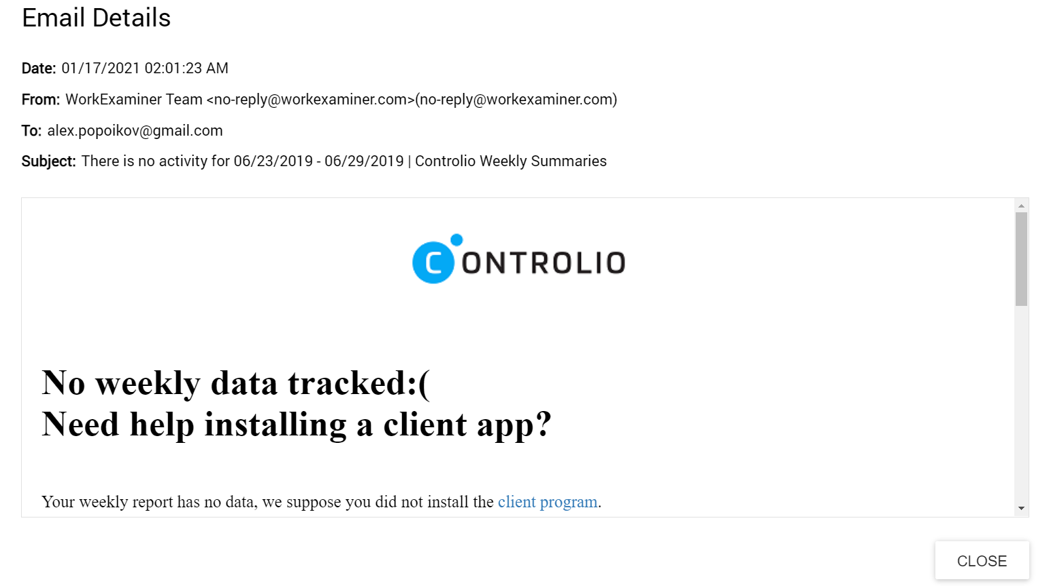
Security Investigations : Emails tracking
E-mails sent, viewed, received, will be downloaded along with attachments for you to view at your leisure!
Tracks e-mails from MS Outlook App, Gmail, Yahoo mail, and Outlook.com.
The report items will be linked with a screen recording that may be used as forensic evidence!

Slide 25
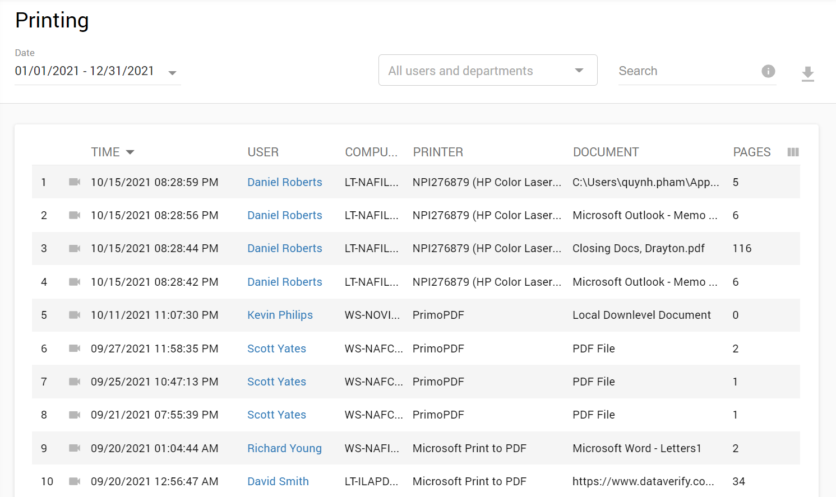
Security Investigations : Printing Operations
Print operations will be logged with all relative info (Document’s name, Number of pages, Printer & PC to fulfill this operation).
The report items will be linked with the screen recording of when the employee initiated the print operation which may also be utilized as forensic evidence!

Slide 26
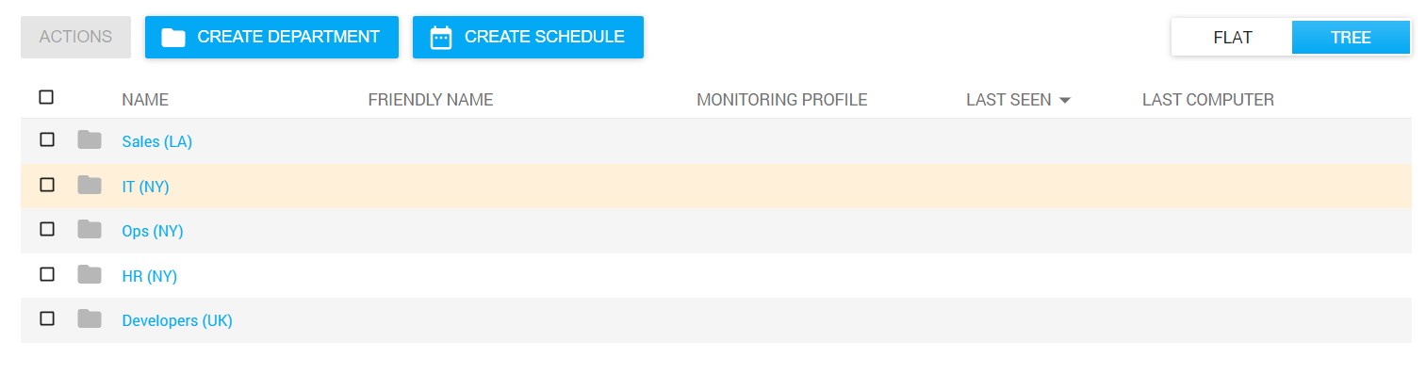
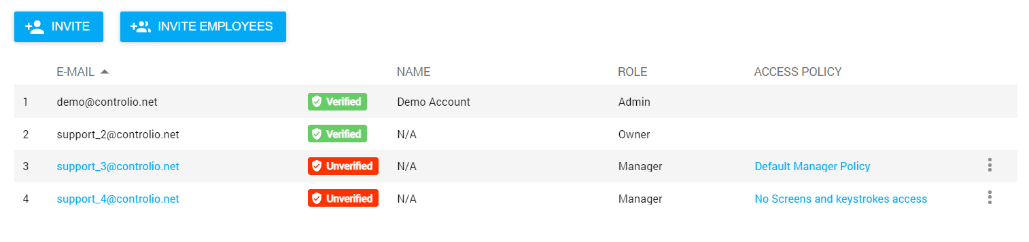
Hierarchical Structure & Policy Managed Access
Set up departments to correspond with your company’s business structure.
Provide each manager with access to his team’s productivity insights.
Allow employees’ to self-monitor to boost their productivity.
Apply monitoring profiles to users & departments (e.g. apply a full monitoring policy for one department and lite-monitoring policies for others).

Slide 27
Hierarchical Structure & Policy Managed Access
Set up departments to correspond with your company’s business structure.
Provide each manager with access to his team’s productivity insights.
Allow employees’ to self-monitor to boost their productivity.
Apply monitoring profiles to users & departments (e.g. apply a full monitoring policy for one department and lite-monitoring policies for others).

Slide 28
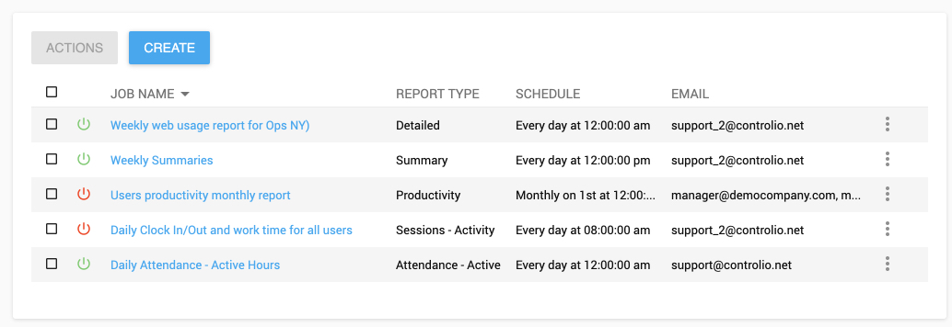
Scheduled Reports
Automate reporting by sending any of the reports in PDF format via email to admins, managers or the top management.
Send weekly digests to employees on their productivity.
Use CSV reports for integration with BI tools and other apps.

Slide 29
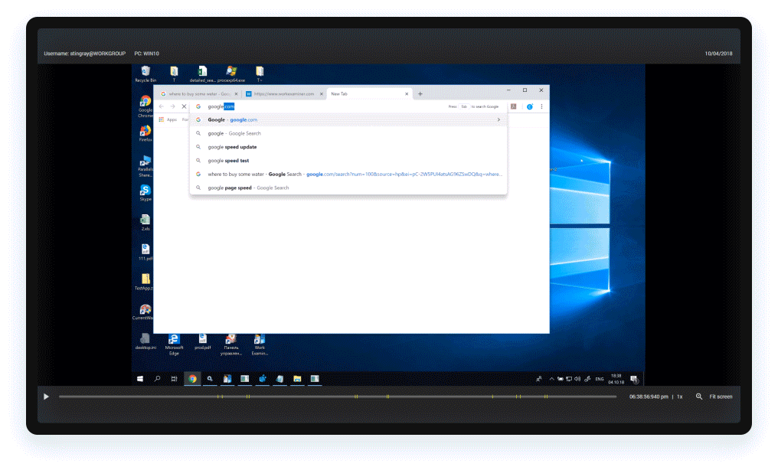
Optional Stealth/Icon Mode
The client agent program can be completely invisible for the user—no icons on the Taskbar or processes in the Task Manager.

Slide 30
Optional GDPR Mode
Any of Controlio’s various tracking functions may switched off to ensure compliance with regulations and security standards.

Slide 31

Secure Cloud System
Your Controlio web dashboard is available from any location or device and at all times. With a secure HTTPS connection, all data is firmly encrypted.

Slide 32
Platform API integration
Integrate Controlio data with your applications and services:
  Get user activity report data
  Sync organizational structure

Slide 33
Contacts
Website: https://controlio.net
E-mail: support@controlio.net
Phone: 800.470.9165 (for calls from inside the U.S.)
+1.619.393.3799 (for calls from outside the U.S.)

